Slide 1

VIDEMUS
We guide the driver.
Plamen Trendafilov | TUM Management & Data Science
Ognyan Trendafilov | AUBG Economics & Finance
ptrendafilov.github.io/Videmus
2026

Slide 2

THE PROBLEM
Drivers need guidance.
1.35M
road deaths / year
Every day, drivers face moments of uncertainty. The result is devastating.
90%
caused by human error
50M
injuries annually

Slide 3
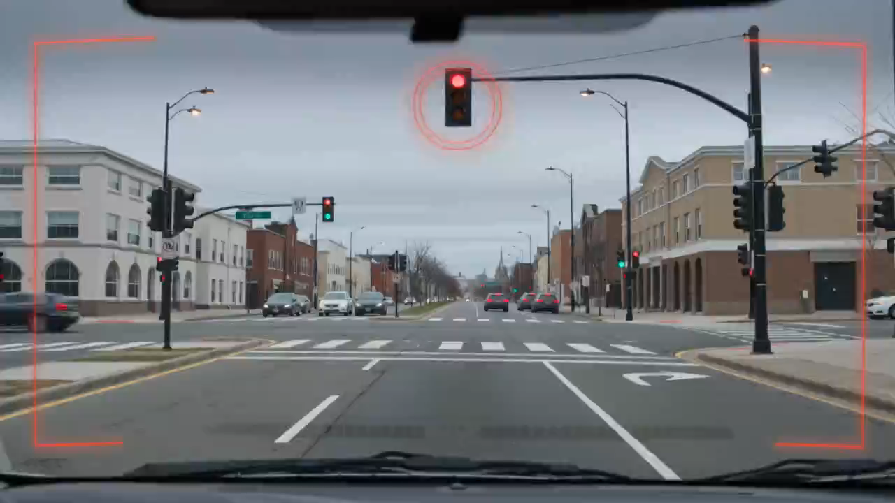

Slide 4
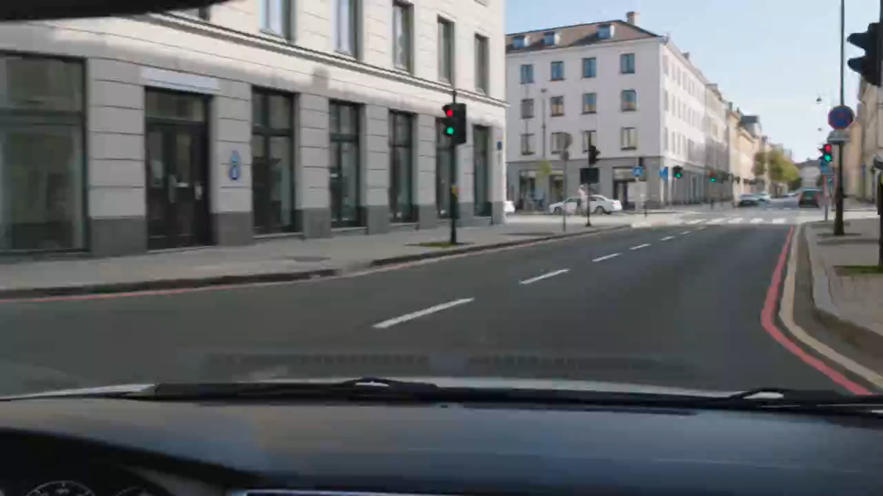

Slide 5
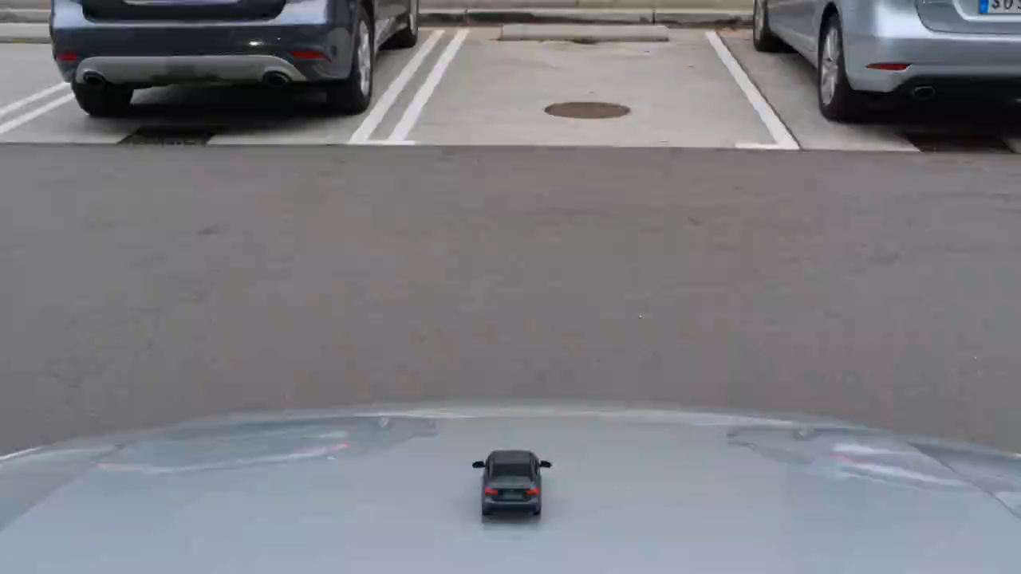

Slide 6
THE SOLUTION
Real-time AR driving guidance.
Videmus uses Computer Vision to observe the road in real time and project AR guidance overlays into the driver’s field of view. The driver stays in full control — we make them better, not replace them.
Traffic Navigation
Road Safety
Parking
The system reads traffic lights and guides with AR overlays.
Real-time detection warns the driver before a dangerous situation.
AR arrows guide the car into tight spaces with precision.

Slide 7
HOW IT WORKS
From camera to guidance.
01
Capture
Surrounding environment is captured through a camera-equipped device, based availability and user convenience (phone, dashcam, etc.)
02
Detect
Video feed is processed by a Computer Vision model, which identifies road landmarks, such as traffic lights and various road signs
03
Analyze
The output passes through a decision layer, with the purpose of calculating optimal action and suggesting it to the driver
04
Guide
An AR overlay is projected, showing visual guidance directly onto the driver’s field of view

Slide 8
PRINCIPLES
We value the safety of our users
01
02
03
04
Safety
Driver assistance
Productive driving
Transparency
Every design choice puts driver and pedestrian safety first, preventing accidents before they happen.
We enhance the human driver with AR guidance, never replacing their control or judgment behind the wheel.
Clear, real-time AR overlays help drivers make faster, smarter, and more confident decisions on the road.
Drivers see what the system detects, building trust through clear and honest communication.

Slide 9
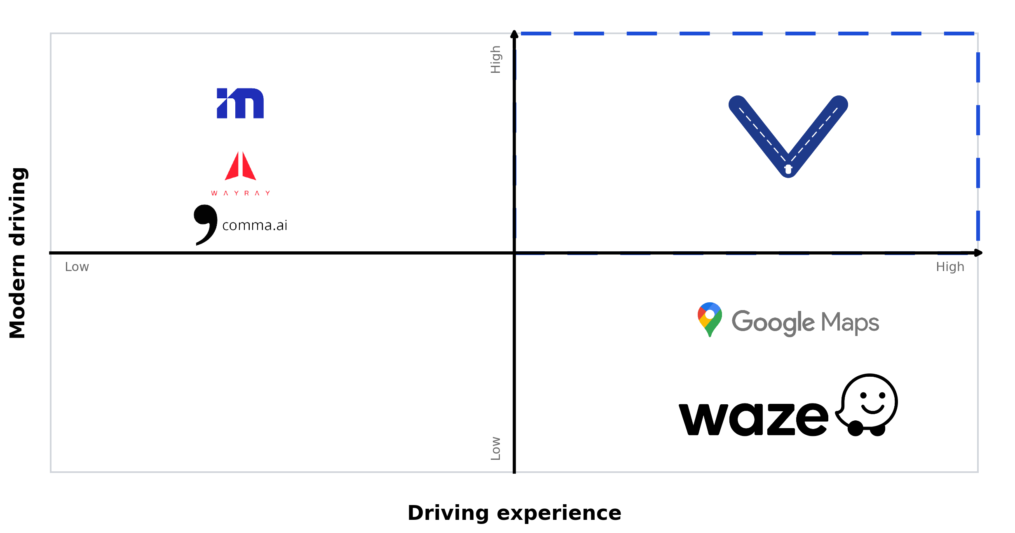
DIFFERENTIATION
We coach. They replace.
Videmus occupies a unique position: enhancing the human driver with modern technology rather than replacing them.

Slide 10
GO-TO-MARKET
Start small. Scale smart.
August 2026
September 2026
October 2026
November 2026
December 2026
Training the model
Integrate models
Launch the MVP
Early testing
Product refinement
Develop and train CV models for traffic light, pedestrian, and parking detection.
Integrate models into a mobile application for real-time driving guidance.
Release the MVP to early adopters for real-world feedback.
Partner with driving schools for testing and validation in controlled environments.
Train the model with the gained data. Improve the app interface from user feedback.

Slide 11
BUSINESS MODEL
How do we monetize Videmus?
B2C
B2C
Free option
Pro plan
One feature free forever, chosen by the user
€1 first month
Other features available via subscription
€10/month or €99/year
Target: 1000 users by January 2027
Pro users unlock all features
KPIs and success metrics
Downloads
Paying customers
Revenue
1000 Users
30 Active Subscriptions
1000€
January 2027
January 2027
March 2027

Slide 12

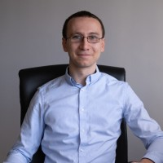
THE TEAM
The right people for the mission.
Plamen Trendafilov
Ognyan Trendafilov
Founder & CEO
Co-Founder & CFO
Management & Data Science Technical University of Munich Product vision, technology, pitch
Economics & Finance American University in Bulgaria Business strategy, partnerships, finance

Slide 13
THE ASK
Raising €5,310 to ship the MVP + our PhD co-founder.
Pre-MVP expenses sourced from the monthly cash-flow model (Jan–Aug 2026), plus a technical partner to own Computer Vision, AR and driving research.
USE OF FUNDS · pre-MVP (Jan–Aug 2026)
THE PROFILE · PhD co-founder we’re looking for
Datasets & Training €3,000 · 56% — Driving-hour dataset license for CV training.
Computer Vision
01
Hardware €1,300 · 24% — RayNeo X3 Pro AI dev unit for AR prototype.
Modern detection & tracking (YOLO/DETR), real-time edge inference.
GDPR / Legal €500 · 9% — Compliance counsel to ship a safety app.
02
Augmented Reality
AR SDKs, HUD overlays — RayNeo, HoloLens, Quest or automotive HUDs.
Storage / Server €400 · 8% — Footage storage + infra for the first cohort.
Publishing & Domain €110 · 2% — App-store fees, website, certificates.
03
Driving & Safety
ADAS, driver-behavior research, road-safety data, a care for ethics.
TOTAL ASK €5,310 funds the prototype through early driving-school tests.
Reach out → plamen.l.trendafilov@gmail.com • ptrendafilov.github.io/Videmus

Slide 14
VIDEMUS
We guide the driver.
plamen.l.trendafilov@gmail.com
ptrendafilov.github.io/Videmus
Thank you!

Slide 15
Annex

Slide 16
MARKET RESEARCH
Large TAM, credible SAM, disciplined SOM.
Bottom-up estimate using FHWA, Pew, ACEA, Eurostat and GSMA inputs.
STRATEGIC IMPLICATION
TAM
€77.3B
Global annual ARR potential
780.9M compatible drivers worldwide (passenger-car fleet × smartphone penetration). €46.9B–€93.7B price sensitivity.
Phone-first distribution. 216M US drivers with smartphones and 228M EU mobile-connected car users
SAM
€11.0B
US + EU serviceable
111.0M users — a 25% slice of the US+EU compatible base fitting parking, pedestrian, and traffic-light use cases.
BASE-CASE SAM MIX
SOM
€4.4M
5-yr base-case ARR
44.4K paying users at 0.04% of US+EU SAM. Range €1.3M–€10.7M depending on share and price.
Learner & novice drivers 45%
Urban parking-heavy drivers 30%
Safety-conscious everyday drivers 25%
Sources: WHO Road Safety 2023 · FHWA Highway Statistics 2023 · Pew 2025 · ACEA · Eurostat · GSMA Intelligence · IDC.

Slide 17
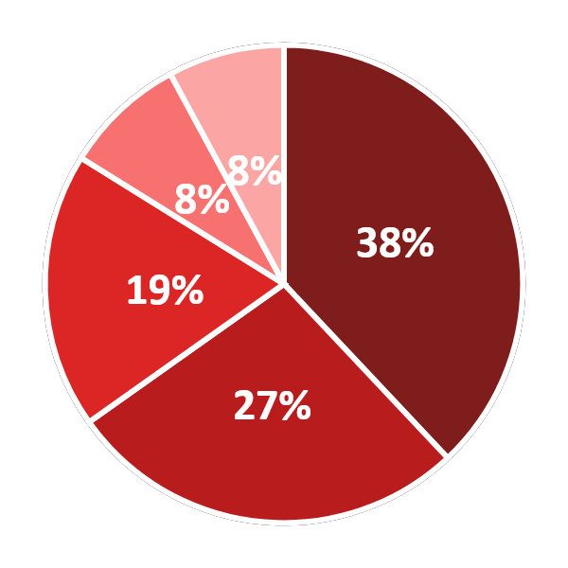
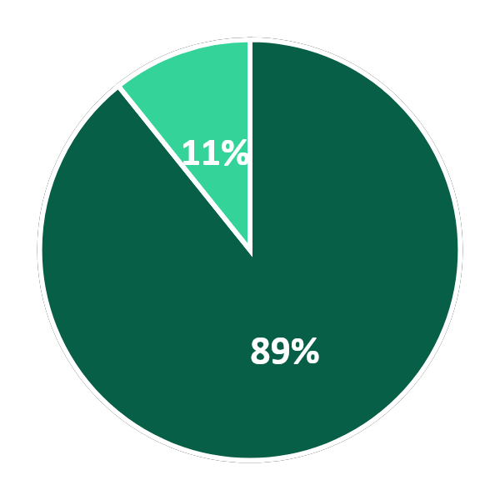
PREDICTED CASH FLOW
Where every euro goes — and comes from.
Projected distribution of costs and revenue across the 3-year model (Jan 2026 – Dec 2028).
COSTS €13,932 total over 3Y
REVENUE €215,516 total over 3Y
Datasets & Training
Subscriptions
€5,292 · 38%
€192,320 · 89.2%
Driving-hour data & model retraining.
Domain & Hosting
Pro plan at €1 first month, €10/mo or €99/year. Ramps from 1 to 1,080 paying users; €8 then €16 blended ARPU.
€3,790 · 27%
Footage storage, servers, domain.
Hardware
€2,600 · 19%
Footage / Data licensing
2× RayNeo X3 Pro AR dev units.
Marketing
€23,196 · 10.8%
€1,150 · 8%
Anonymized driving-hour datasets sold to AV labs & ADAS researchers. Starts small, scales with active users.
Ads, content, launch — €25–€50/mo.
Legal & Publishing
€1,100 · 8%
GDPR counsel + app-store fees.
Revenue outpaces cost ~15× over 3 years • NPV @ 10%: €75.9K • IRR: 17.4% • Break-even: March 2028 — see next slide for monthly trajectory.

Slide 18
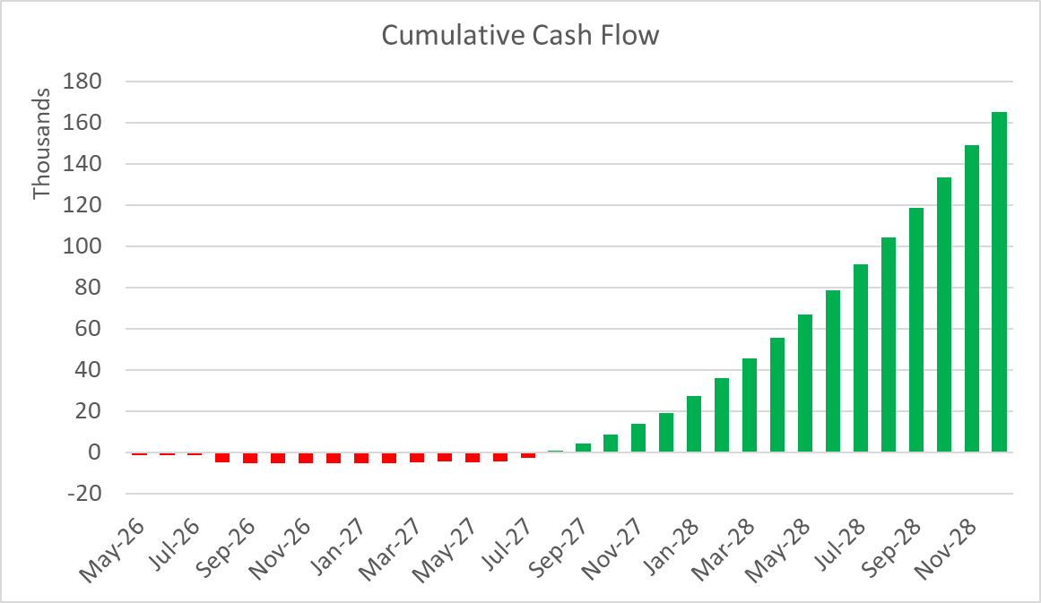

Slide 19
THE ASK
Raising €5000 to ship the MVP.
USE OF FUNDS
THIS CAPITAL GETS US TO
AR Glasses (1)
€1300
▸
Glasses-based prototype tested in 3 partner schools
RayNeo X3 Pro AI dev units for the prototype
▸
10 signed instructor LOIs
Co-founder
Wanted
▸
First real-world safety + UX data on glasses
To train the CV model and build the company with us
▸
Ready for paid pilots and a seed round
Software
€3500
Development, publishing, training costs, and operating requirements

Slide 20
TRACTION
What we’ve built so far.
Brand & Identity
Concept Videos
Logo, visual identity, and motto established.
Three AR guidance demos produced: parking, pedestrian, and traffic light scenarios.
Baseline Model
Competition Selected
YOLOv8 trained on traffic lights, cars, pedestrians detection dataset. Validated on real driving footage video below and GITHUB
Finalist in Sofia pitch competition with guaranteed prize and HP advisor assigned.
Incubator Pipeline
Website
Application prepared for Constructor Start
Creation of website for the product - https://ptrendafilov.github.io/Videmus

Slide 21
